Slide 1
Decision Support System’s Crime in St. Louis Study
By:
Group D
Brian Howard
Dhiraj Kumar
Katie Vogel
Tim Stahlman

Slide 2
Objective
To predict where crime will occur in the city of St. Louis
  Specifically homicides
We are to predict the location and number of unlawful homicides where there is intent to kill in St. Louis City for 2011

Slide 3
Project Process
Collect the data
Analyze (Data Mining)
    Formulate the problem.
    Accumulate data.
    Transform and select data.
    Train models.
    Evaluate models.
    Deploy models.
    Monitor results.
Present the result

Slide 4
Current Statistics for the City of St. Louis - July 2009
According to City-data.com:
  St. Louis’s population is 356,587
  There are 5,758 people per square mile
  68,917 county owner-occupied houses and condos
  78,159 renter-occupied apartments

Slide 5
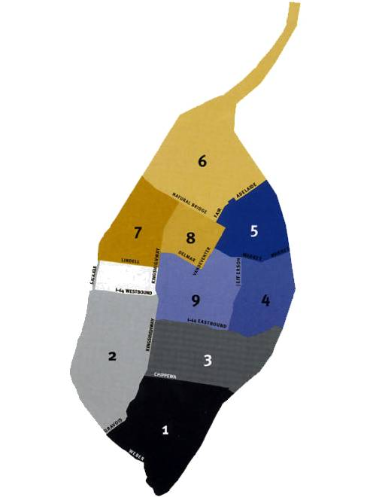

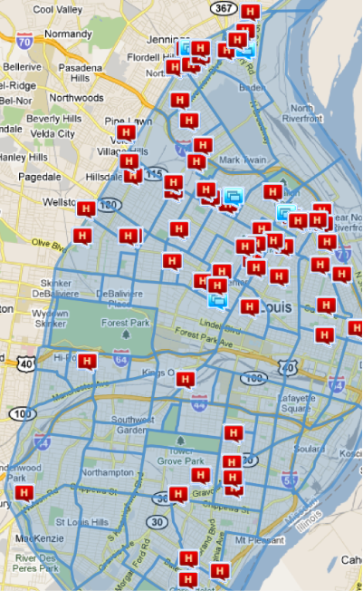
Map of St. Louis By District:
Homicides

Slide 6
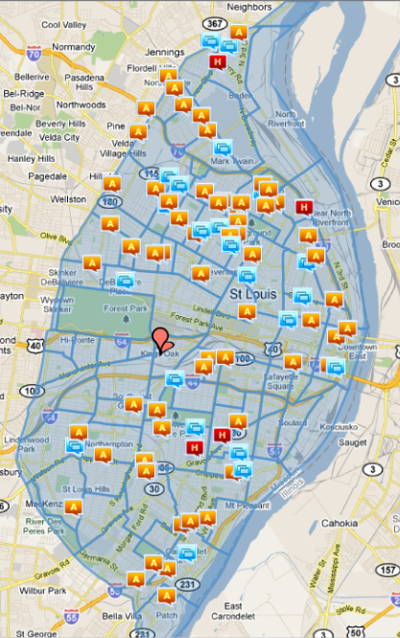
Map of St. Louis By District:
Related Crime

Slide 7
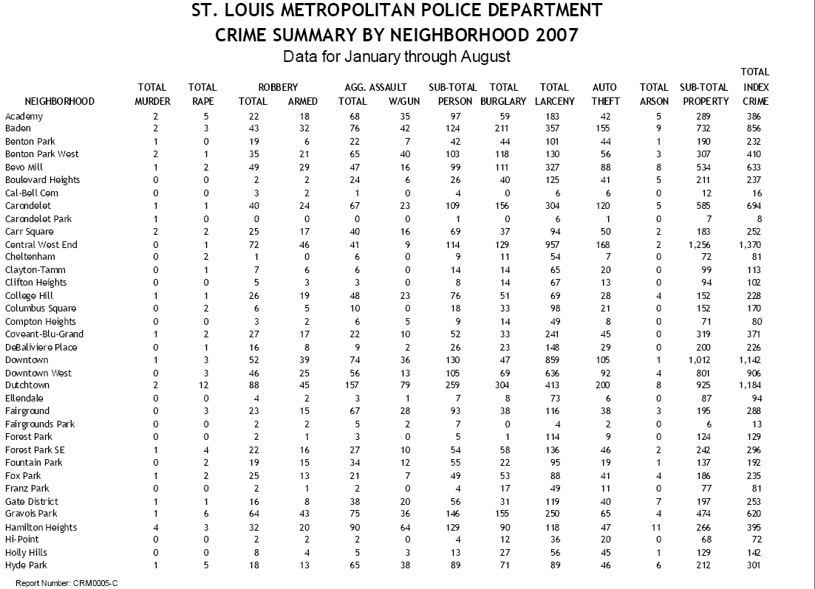
Sample Data By Neighborhood
Notes:
Source: http://slmpd.org/crime_stats.html

Slide 8
Crime Statistics 2010
District | Total Murder
District – 1 | 10
District – 2 | 4
District – 3 | 10
District – 4 | 9
District – 5 | 30
District – 6 | 39
District – 7 | 21
District – 8 | 14
District – 9 | 7
Unknown | 0
TOTAL | 144

Slide 9
Crime Statistics 2009
District | Total Murder
District – 1 | 9
District – 2 | 2
District – 3 | 13
District – 4 | 13
District – 5 | 25
District – 6 | 27
District – 7 | 29
District – 8 | 17
District – 9 | 8
Unknown | 0
TOTAL | 143

Slide 10
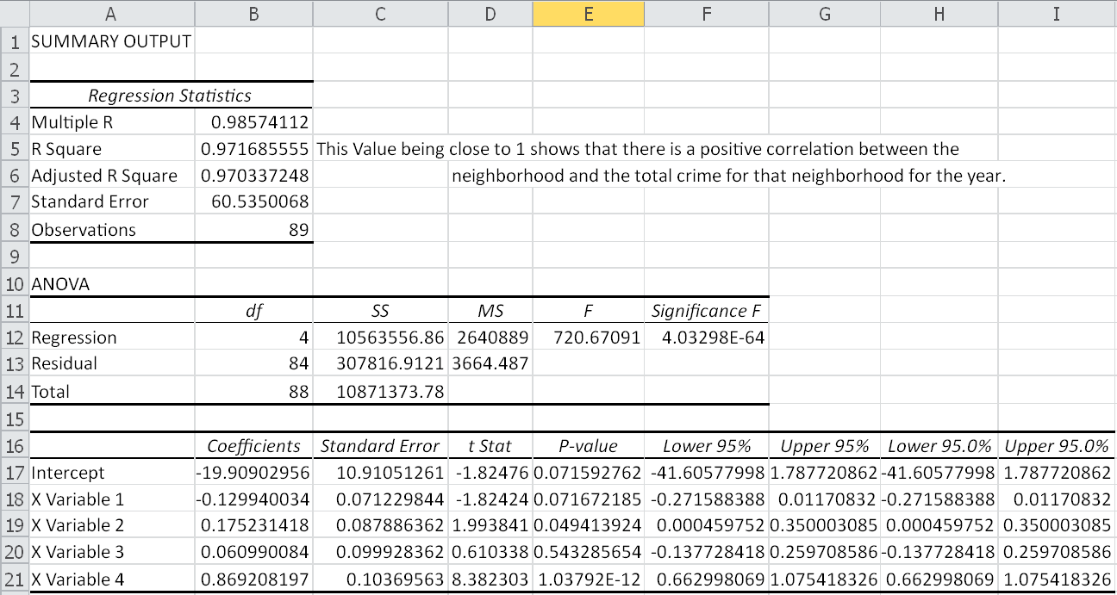
Relationship Between Neighborhood and Total Crime

Slide 11
Model A Variables
X1: Year 2007
X2: Year 2008
X3: Year 2009
X4: Year 2010

Slide 12
Formula
Y = -0.13(x1)+0.175(x2)+.0661(x3)+.869(x4 ) – 19.909

Slide 13
Regression Statistics
Multiple R | 0.98574112
R Square | 0.97168555
Adjusted R Square | 0.970337248
Standard Error | 60.5350068
No. of Observations | 89

Slide 14
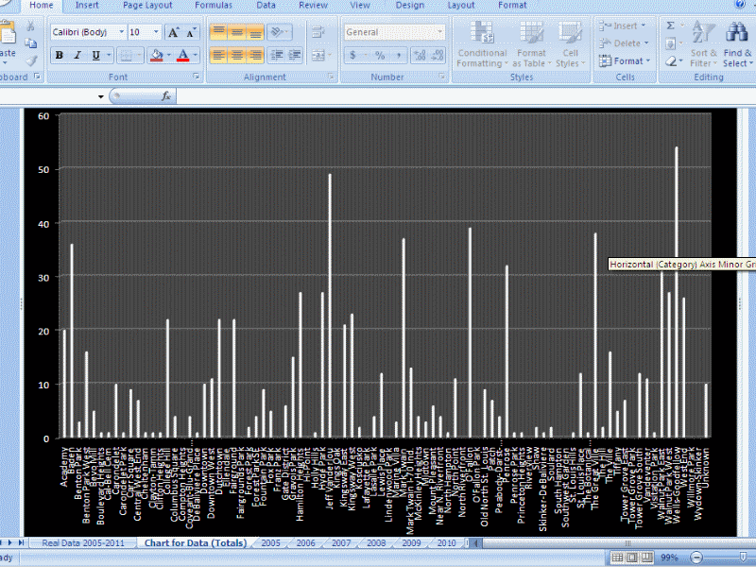
Crime Data

Slide 15
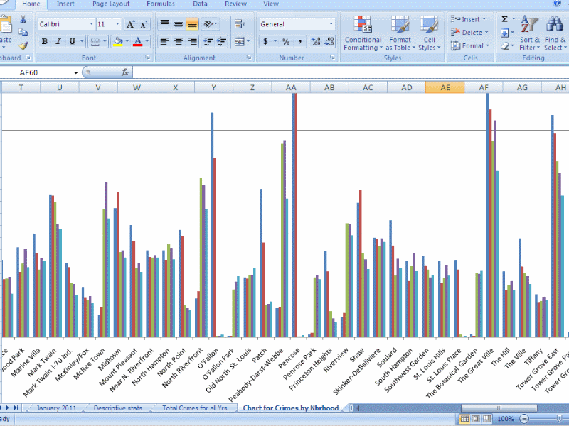
Crime By Neighborhood

Slide 16
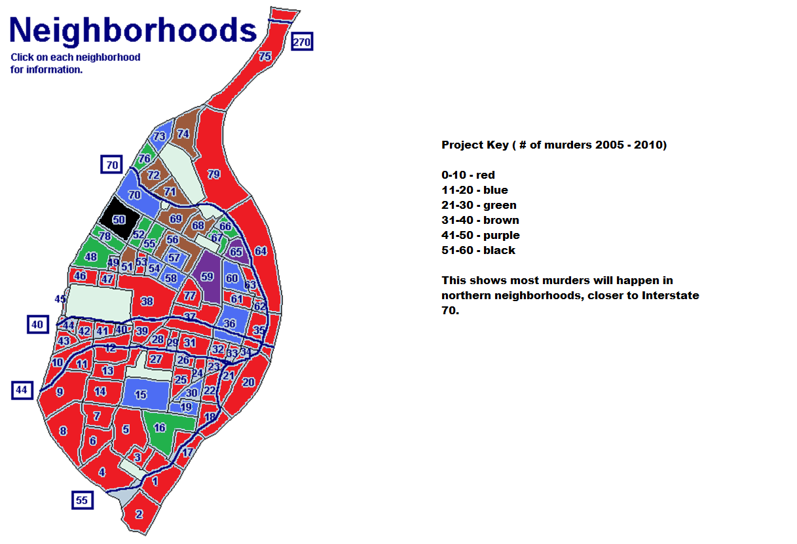
Forecast

Slide 17
Summary of Results
There is a direct correlation between the neighborhood location and the homicide rate
Neighborhoods within wards 5, 6 and 7 contain the worst homicide rates
These areas are close to Interstate 70

Slide 18
References
V.L. Sauter, Decision Support Systems For Business Intelligence, New York: John Wiley & Sons, 2011.
Analytics X. N.p., 2011. Web. 1 Mar. 2011. <http://www.analyticsx.com/rulesfaq.html>.
"Crime Statistics." Metropolitan Police Department. N.p., 2011. Web. 1 Mar. 2011. <http://slmpd.org/crime_stats.html>.
Tonya, Balan: Understanding Analytix, SASCom Magazine, Jan, 2010
Sauter, Vicki L. Decision Support Systems for Business Intelligence. Ed. Vicki L. Sauter. University of Missouri - St. Louis, 15 Jan. 2011. Web. 1 Mar. 2011. <http://www.umsl.edu/~sauterv/DSS/6833start.html>.

Slide 19

Questions

